Slide 1
NAME : KARTHIGAI KANNAN K
REG.NO :311521104024
DEPT :CSE
COLLEGE :MEENAKSHI SUNDARARAJAN ENGINEERING COLLEGE
NAAN MUDHALVAN ID: au311521104024
GMAIL ID: iamkarthigaikannank@gmail.com
DALL-E Image Generator Using OpenAI, Flask & Replit
3/21/2024 Annual Review

Slide 2
PROJECT TITLE
DALL-E IMAGE GENERATOR USING OPENAI,FLASK & REPLIT
3/21/2024 Annual Review

Slide 3


AGENDA
Problem statement
Proposed solution
System development architecture
Project overview
Algorithm and deployment
Solution after deployment
Result
Conclusion
References
3/21/2024 Annual Review

Slide 4

PROBLEM STATEMENT
There exists a need for a user-friendly and accessible tool that facilitates the generation of images from textual prompts, catering to individuals across various domains such as education, design, and creative expression. Current solutions often lack ease of use, requiring specialized knowledge or sophisticated software, hindering widespread adoption and limiting the creative potential of users.
Furthermore, there is a gap in the availability of platforms that seamlessly integrate advanced AI-driven image generation capabilities, such as those offered by OpenAI's Dall-E model, with user-friendly interfaces, hindering users' ability to translate textual ideas into visual representations efficiently.
3/21/2024 Annual Review

Slide 5
PROPOSED SOLUTION
The proposed solution is to develop a web-based image generation platform that utilizes OpenAI's Dall-E model to generate images from textual descriptions. The solution will consist of a frontend user interface implemented using HTML, CSS, and JavaScript, allowing users to input textual prompts easily. The backend will be developed using Python Flask, facilitating communication with the OpenAI API for image generation.
Upon receiving a textual prompt from the user, the backend will send a request to the OpenAI API, which will utilize the Dall-E model to generate corresponding images. The generated images will then be returned to the frontend and displayed to the user in real-time.
The solution will prioritize user-friendliness, providing a simple and intuitive interface for users to interact with. Error handling and validation will be implemented to ensure a smooth user experience, with informative feedback provided in case of errors or invalid inputs.
Additionally, the solution will incorporate security measures to protect user data and ensure the confidentiality and integrity of the application. This includes securely handling API keys and implementing best practices for data transmission and storage.

Slide 6
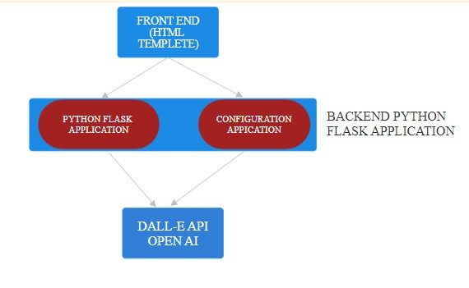
SYSTEM DEVELOPMENT ARCHTECTURE

Slide 7

PROJECT OVERVIEW
Key Features:
Textual Prompt Input: Users can input textual prompts or descriptions through a simple web interface.
Image Generation: The application utilizes OpenAI's Dall-E model to generate images based on the provided textual prompts.
Real-time Results: Generated images are displayed to users in real-time, allowing for immediate feedback and exploration.
Scalability: The application is designed to scale to accommodate increased demand and usage.
User-Friendly Interface: The frontend interface is intuitive and accessible, catering to users with varying levels of technical expertise.
3/21/2024 Annual Review

Slide 8
PROJECT OVERVIEW
Technologies Used:
Frontend: HTML, CSS, JavaScript
Backend: Python Flask
Machine Learning: OpenAI Dall-E API
Deployment: Replit (Cloud-based development platform)
3/21/2024 Annual Review

Slide 9
PROJECT OVERVIEW
Project Goals:
Accessibility: Provide a user-friendly platform that enables users from diverse backgrounds to effortlessly generate images from textual prompts.
Innovation: Harness advanced machine learning technology to offer cutting-edge image generation capabilities to users.
Education: Foster creativity and exploration by providing a tool for generating visual representations of textual ideas and concepts.
Scalability: Ensure the application is capable of handling increased traffic and usage as it gains popularity and adoption.
3/21/2024 Annual Review

Slide 10
PROJECT OVERVIEW
Future Enhancements:
Improved User Interface: Enhance the frontend interface with additional features and customization options for users.
Model Fine-Tuning: Explore techniques to fine-tune the Dall-E model for specific domains or use cases to improve image quality and relevance.
Integration with External Platforms: Integrate the image generation capabilities with external platforms and services to expand the reach and functionality of the application.
Collaborative Features: Implement features that allow users to collaborate on image creation and share generated images with others, fostering a sense of community and collaboration.
3/21/2024 Annual Review

Slide 11

WHO ARE THE END USERS?
Artists and Designers
Educators and Students
Content Creators
Researchers and Developers
Businesses and Marketers
Casual Users
3/21/2024 Annual Review

Slide 12
ALGORITHM AND DEPLOYMENT
Here's a simplified overview of the algorithm:
Input Processing: When a user submits a textual prompt through the web interface, the input is preprocessed to ensure compatibility with the Dall-E model. This may involve tokenization, encoding, and other text preprocessing steps.
Image Generation: The preprocessed textual prompt is then fed into the Dall-E model, which has been trained on a vast dataset of images and corresponding textual descriptions. The model generates images that best match the given prompt, leveraging its understanding of visual concepts and textual semantics.
Post-processing: The generated images are then post-processed as needed, which may include resizing, cropping, or other adjustments to ensure they meet the desired specifications and quality standards.
Output Delivery: Finally, the generated images are returned to the user through the web interface, where they can be viewed, downloaded, or further manipulated as desired.

Slide 13
ALGORITHM AND DEPLOYMENT
Deployment:
For deployment, the Dall-E Image Generator project can be hosted on a cloud-based platform such as Replit, Heroku, AWS, or Google Cloud Platform. Here's an overview of the deployment process:
Setup Environment: Choose a cloud-based development platform and set up the necessary environment for hosting the web application. This may involve creating an account, setting up project directories, and configuring development tools.
Install Dependencies: Install the required dependencies for the project, including the Flask web framework, any Python libraries used for interfacing with the OpenAI API, and other dependencies specified in the project's requirements.
Configure API Access: Obtain an API key from OpenAI for accessing the Dall-E model. Store the API key securely, either as an environment variable or in a configuration file, to ensure it is not exposed publicly.

Slide 14
ALGORITHM AND DEPLOYMENT
Deploy Application: Deploy the Flask application to the chosen cloud platform, following the platform-specific deployment instructions. This typically involves uploading the project files, configuring server settings, and starting the application.
Testing and Monitoring: Test the deployed application to ensure it functions correctly in a live environment. Monitor the application for performance, reliability, and security, and make any necessary adjustments or optimizations.
Scaling: As the application gains users and traffic, consider scaling the deployment to handle increased demand. This may involve upgrading server resources, implementing load balancing, or deploying additional instances of the application.
Maintenance: Regularly maintain and update the deployed application to ensure it remains secure, reliable, and up-to-date. This includes applying security patches, fixing bugs, and adding new features or improvements as needed.

Slide 15
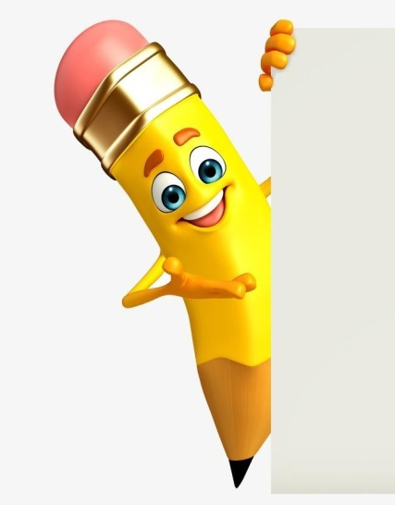
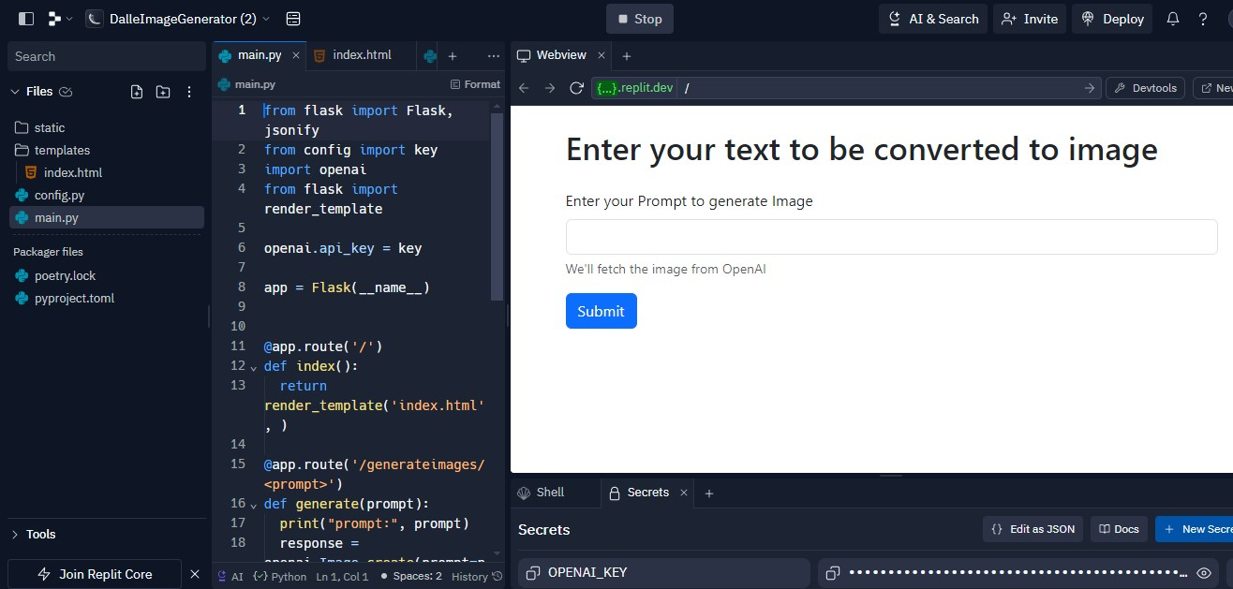
SOLUTION AFTER DEPLOYMENT
3/21/2024 Annual Review

Slide 16
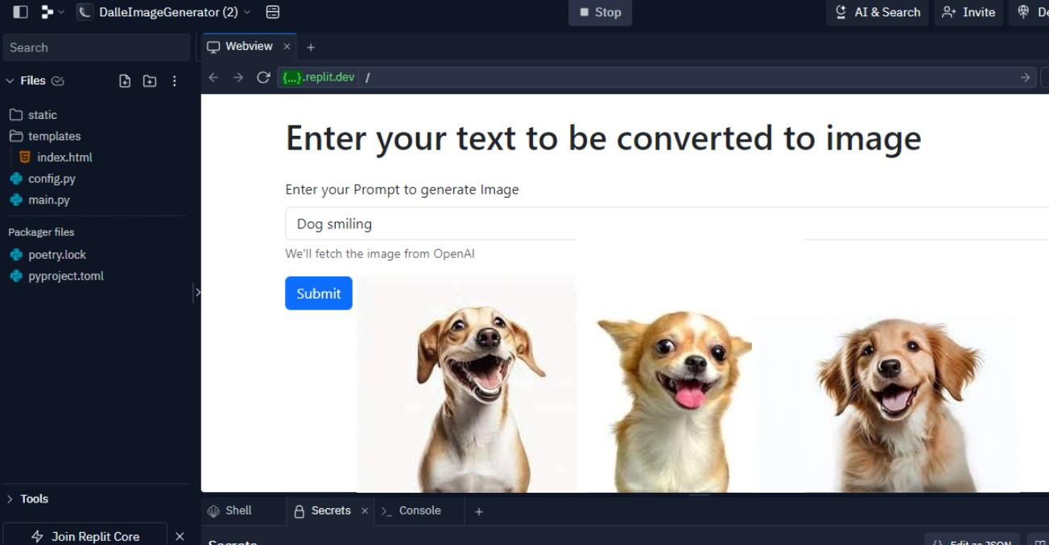
SOLUTION AFTER DEPLOYMENT
3/21/2024 Annual Review

Slide 17

RESULT
The result of the Dall-E Image Generator project is a user-friendly web application that enables users to generate images from textual prompts using OpenAI's Dall-E model. Users can input textual descriptions through a simple interface, and the application leverages advanced machine learning algorithms to generate corresponding images in real-time.
The generated images are displayed to users instantly, allowing for immediate feedback and exploration.
Overall, the result of the Dall-E Image Generator project is a powerful tool for creative exploration and expression, empowering users to visually depict their ideas and concepts with ease and precision.
3/21/2024 Annual Review

Slide 18
CONCLUSION
In conclusion, the Dall-E Image Generator project encapsulates the harmonious fusion of cutting-edge technology and creative expression, offering users an enchanting journey into the realm of AI-driven image synthesis. With a seamless interface and instantaneous results, this platform transcends boundaries, empowering individuals from all walks of life to effortlessly transform textual prompts into captivating visual masterpieces.
As users embark on this imaginative voyage, they unlock a realm of endless possibilities, where the boundless creativity of the human mind intertwines with the computational prowess of AI. From artists seeking inspiration to educators enriching learning experiences, from marketers crafting captivating content to curious minds exploring the frontiers of technology, the Dall-E Image Generator beckons to all, inviting them to unleash their imagination and bring their visions to life.
3/21/2024 Annual Review

Slide 19
REFERENCES
https://openai.com/blog
https://towardsdatascience.com
https://blog.replit.com
https://www.geeksforgeeks.org/build-blog-website-using-flask
Demo Link
3/21/2024 Annual Review

